Slide 1
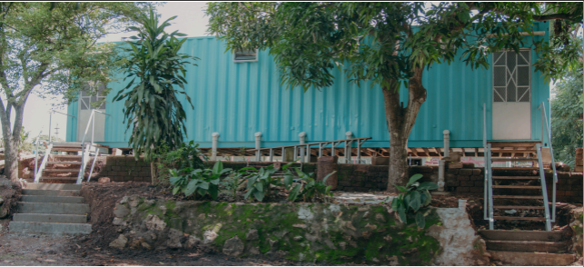
Thank You for Donating
Bethel Bathroom Project
$83,000 raised

Slide 2
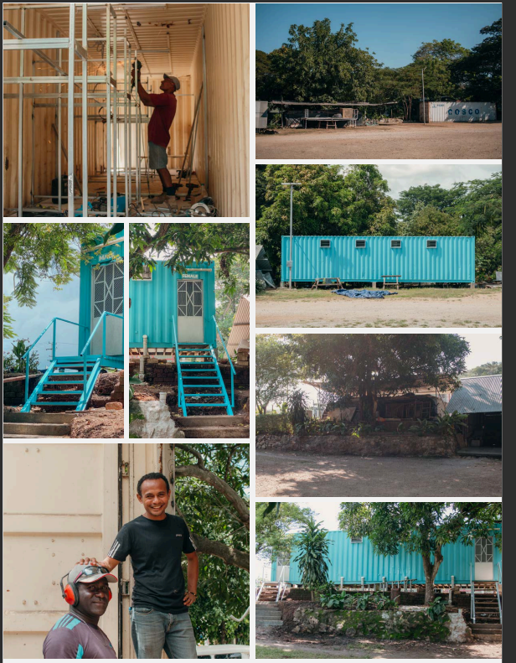
We have built:
Finance office extension & missions office relocation
Accessible bathroom for Gabi Wari
Staff house bathroom
New container toilet block
Shared bathroom block upgrade

Slide 3
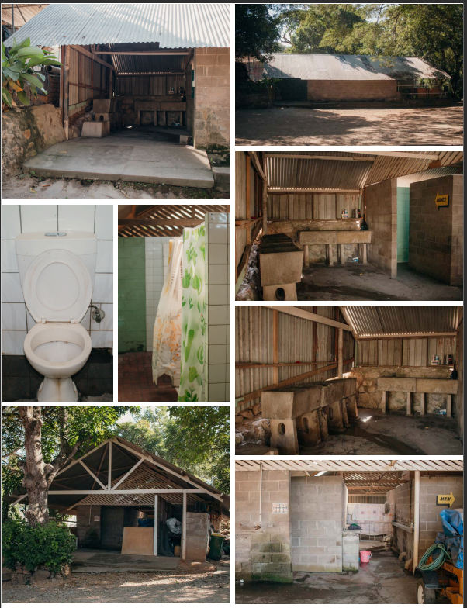
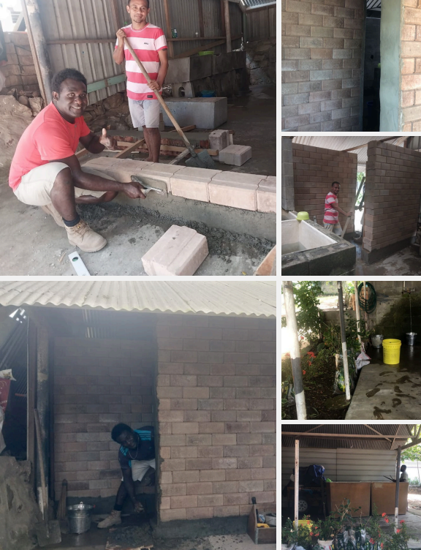
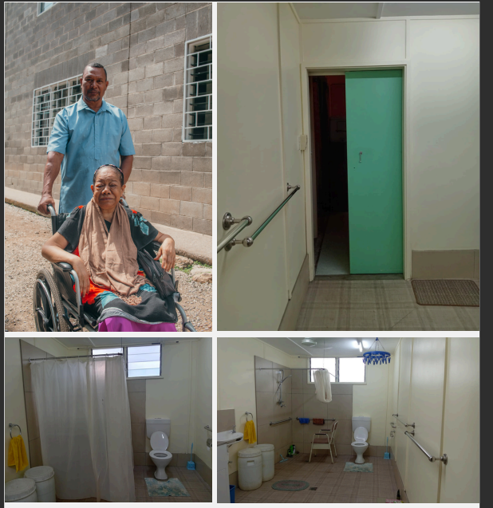
Thank you for helping us build a lasting legacy!
$83,000 raised

